Slide 1
The Barnes Hut Approximation
Efficient computation of N-body forces BY – ROHAAN ADVANI - 111903151
In physics, the N-body problem is the problem of predicting the individual motions of a group of celestial objects interacting with each other gravitationally.
The Barnes Hut Approximation method to calculate N-body force: To accelerate computation and make large-scale simulations possible, long-range forces are replaced by a group of distant points with their center of mass. In exchange for a small amount of error, this scheme significantly speeds up calculation, with complexity n log n rather than n².
An N-body simulation approximates the motion of particles, often specifically particles that interact with one another through some type of physical forces.
Central to this approximation is a spatial index: a “map” of space that helps us model groups of points as a single center of mass. In two dimensions, we can use a quadtree data structure, which recursively subdivides square regions of space into four equal-sized quadrants. (In three dimensions, one can use an analogous octree that divides a cubic volume into eight sub-cubes.)
The conventional method to calculate N-body force:
A straightforward approach to computing N-body forces is to consider all pairs of individual points and add up the contributions of each interaction. This naïve scheme has quadratic complexity: as the number of points n increases, the running time grows proportionally to n², quickly leading to intractably long calculations.
The Barnes-Hut approximation involves three steps:
Construct the spatial index (e.g., quadtree/octree)
Calculate centers of mass
Estimate forces

Slide 2
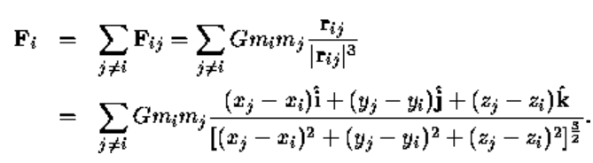
Calculate N-body Force:
Project Stages:
Stage 1: Quadtree/Octree and functions (can also add more functions and features such as displaying or updating positions & boundaries)
Stage 2: Performing approximation calculations using quadtree/octree nodes with BarnesHut Functions to calculate center of mass for all BarnesHutPoints.
Stage 3: Calculation of N body Force between this com and an arbitrary body & Functions calculating & displaying time complexity analysis.
APPLICATIONS:
1. NEWTONS FORCE :
Make a subprogram with relative positions (Latitude(x), Longitude(y) & Altitude(z)) and masses of system of satellites using live tracking and calculate N body forces for the same.
2. COULUMBS FORCE :
Make a subprogram with a system of charges with positional and charge information in a coordinate plane and calculate N body forces for the same.
Ignoring the quadtree/octree, we can naively calculate forces by summing the contributions of all individual points. Of course, we would instead like to use the quadtree/octree to accelerate calculation and approximate long-range forces. Rather than compute interactions among individual points
Let the total force on particle i be Fi. It is the sum of all the forces from all the other particles. Thus the total force Fi on particle i is :
Conventional Calculated Time Complexity: n*n
Barnes Hut Calculated Time Complexity: n*log(n)
Function Required:
Calculate N body force

Slide 3
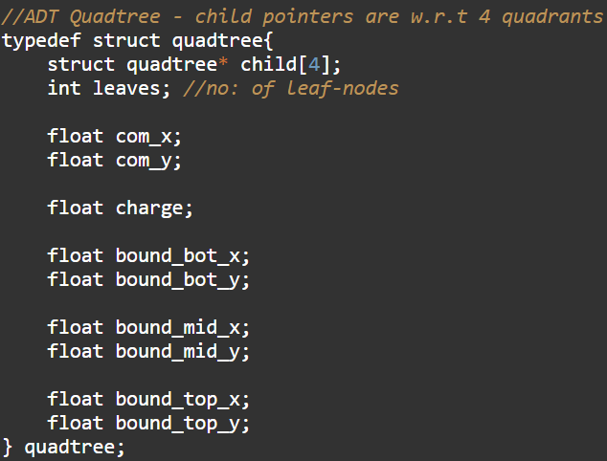
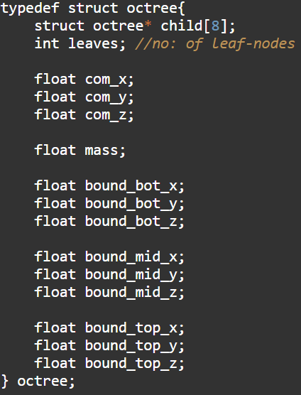
STEP 1: BUILD CASEWISE ADT QUADTREE / OCTREE
KEY VARIABLE - CHARGE
KEY VARIABLE - MASS

Slide 4
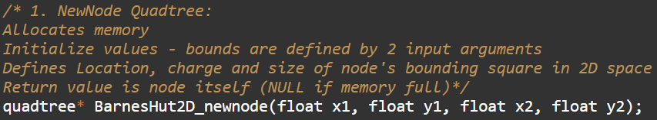
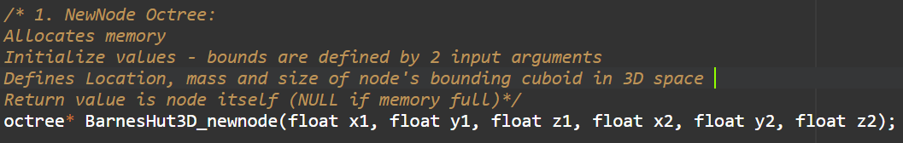
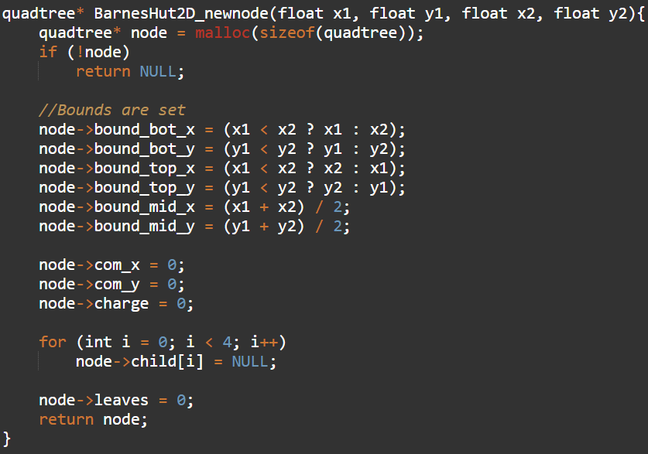
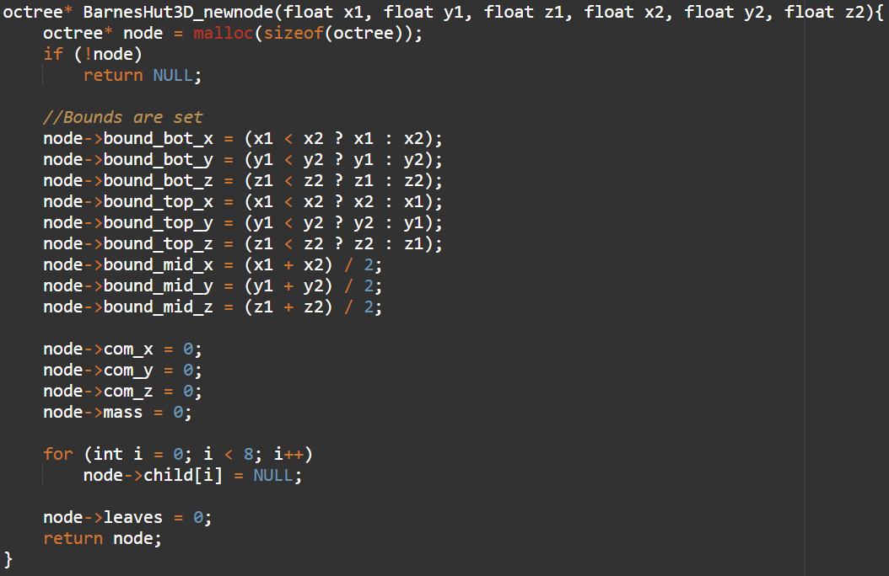
STEP 2: INITIALIZE / NEWNODE FUNCTION

Slide 5


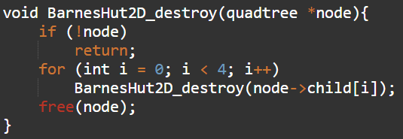
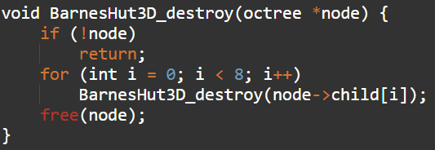
STEP 3: DESTROY / FREE FUNCTION USING RECURSION

Slide 6


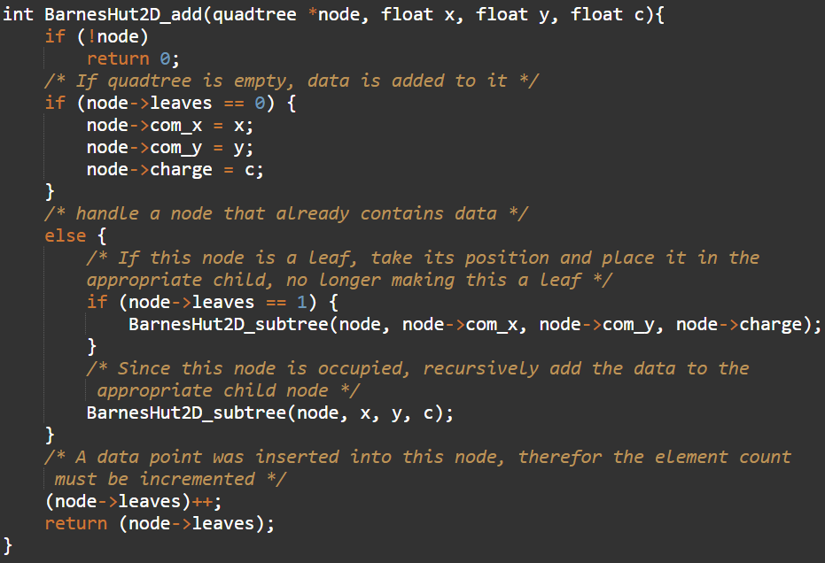
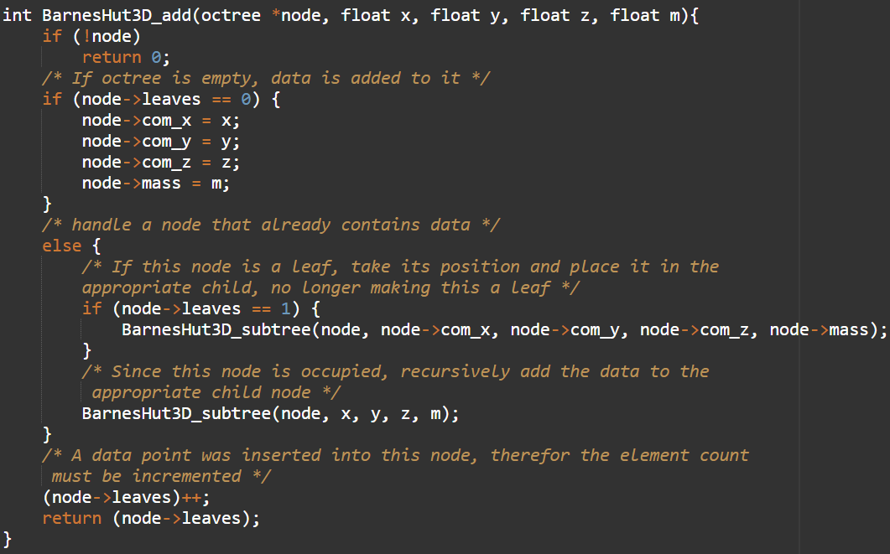
STEP 4: ADD FUNCTION – ADDING NODES TO SYSTEM

Slide 7

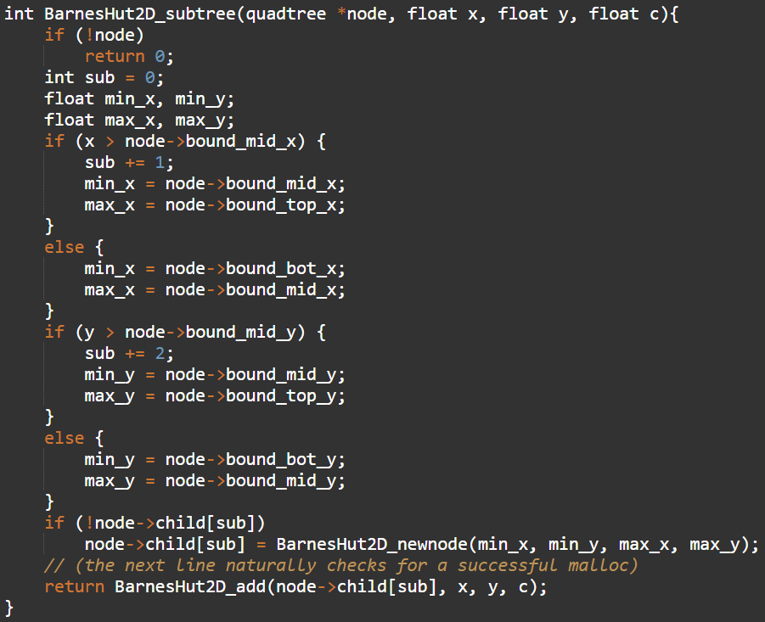
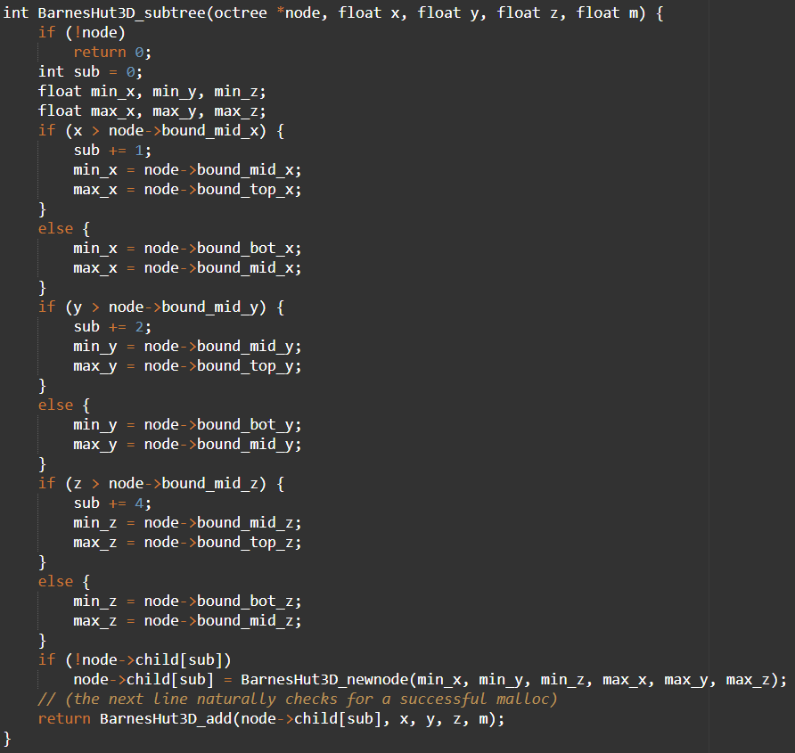
STEP 5: SUBTREE HELPER FUNCTION – ADDING NODES TO RESPECTIVE QUADRANT / OCTANT

Slide 8
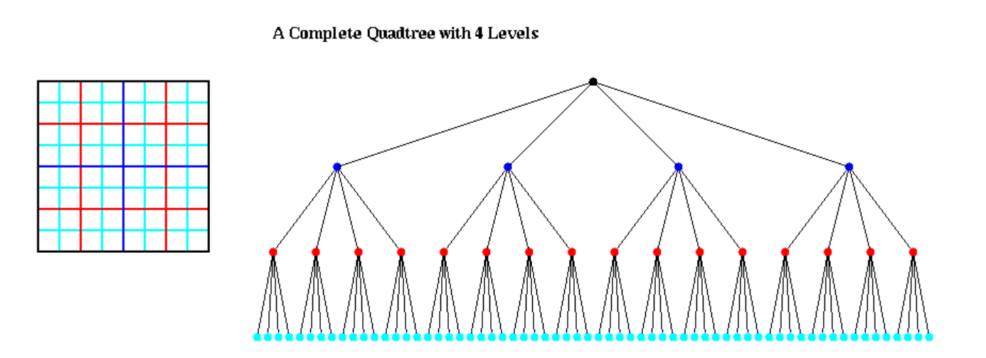
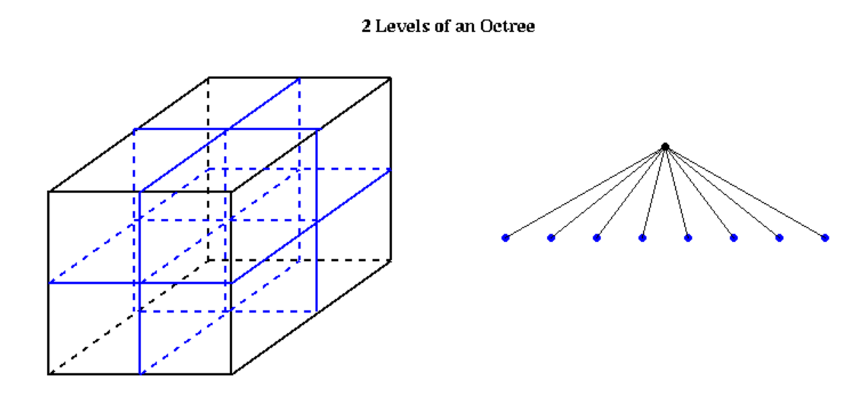
STEP 6: DIAGRAMATIC REPRESENTATION OF BUILT ADT’S
2D
3D

Slide 9


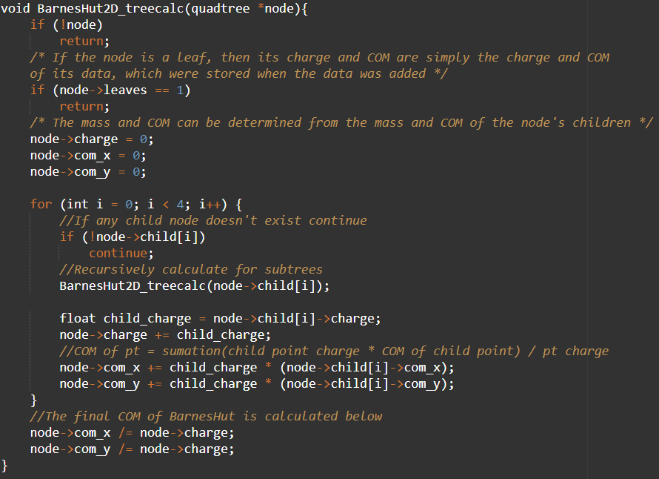
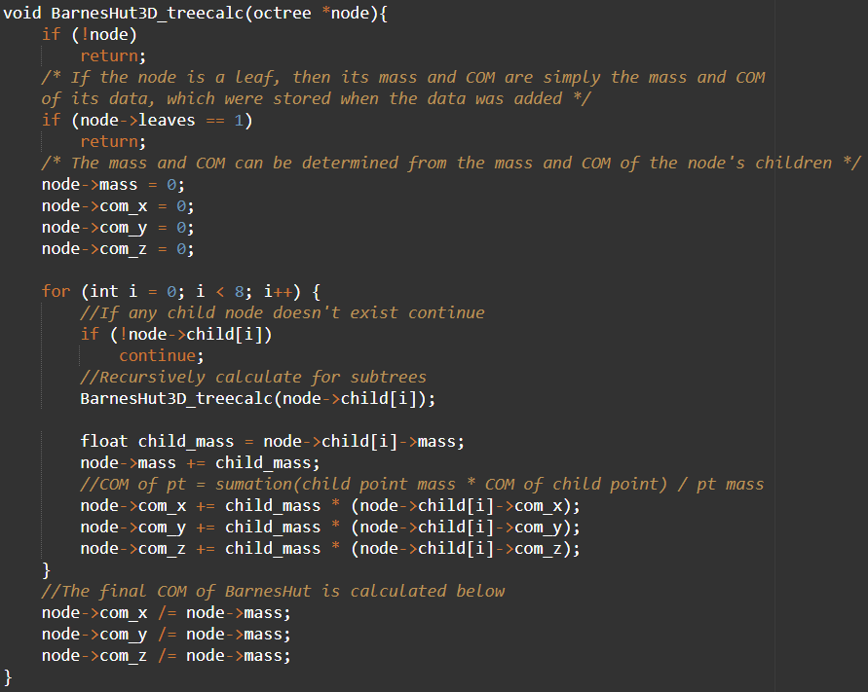
STEP 7: TREE CALCULATION USING BARNES HUT ALG.

Slide 10
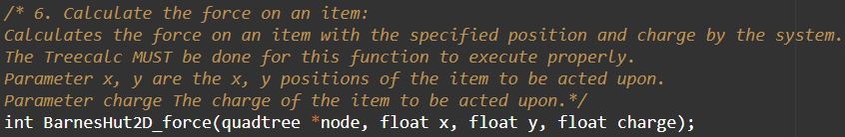
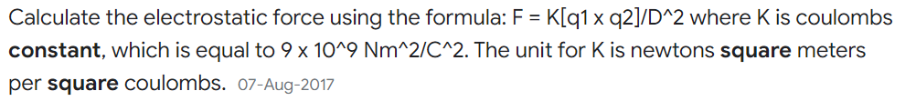
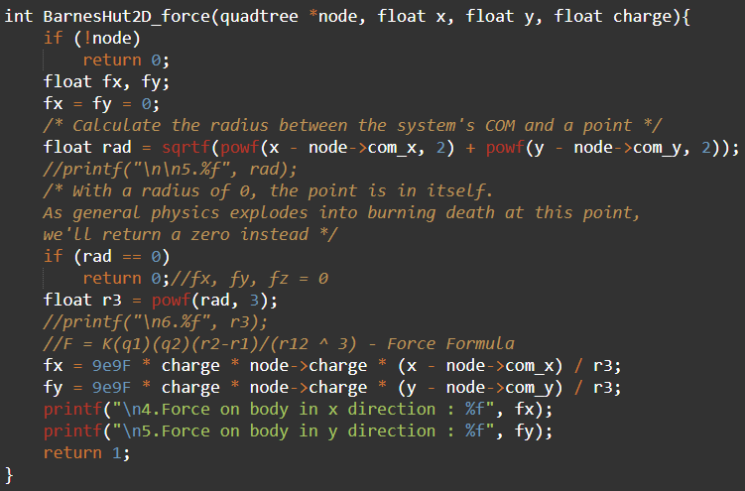
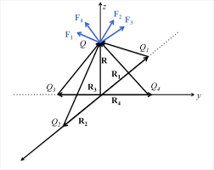
STEP 8: CALCULATION OF COULUMBS FORCE USING QUADTREE

Slide 11
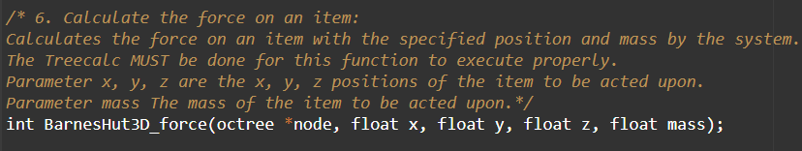
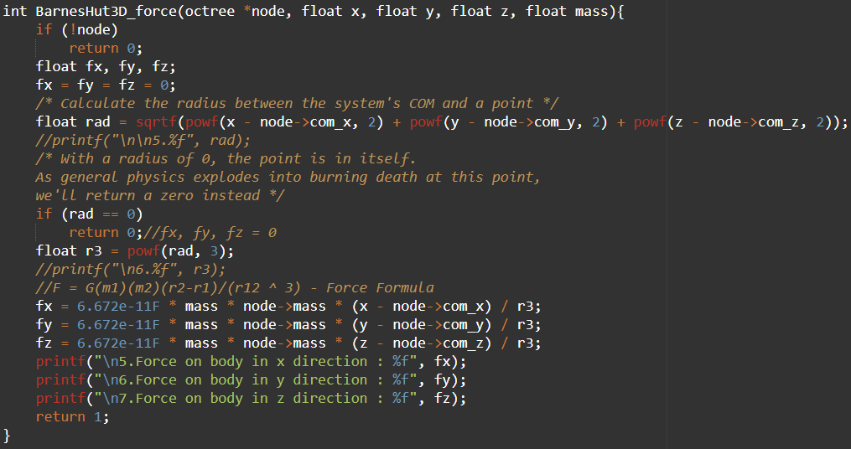
STEP 9: CALCULATION OF NEWTONS FORCE USING OCTREE

Slide 12


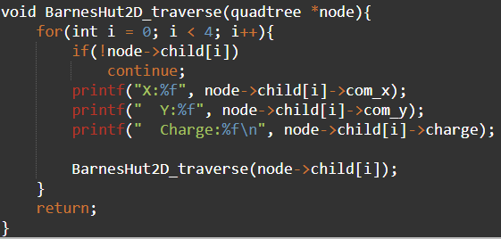
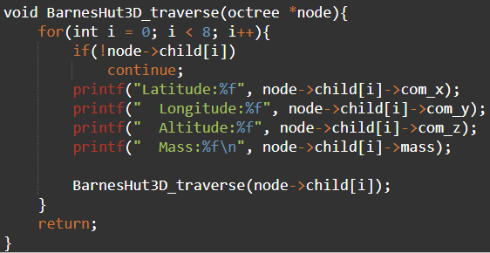
STEP 10: TREE TRAVERSAL FUNCTION – 2D / 3D

Slide 13
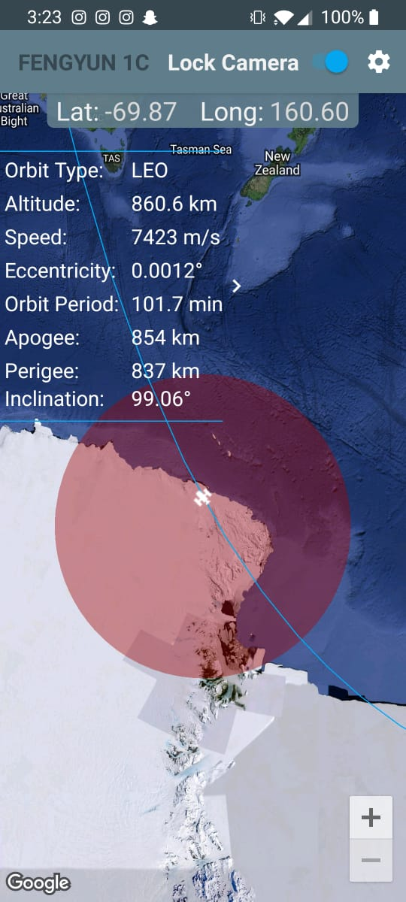
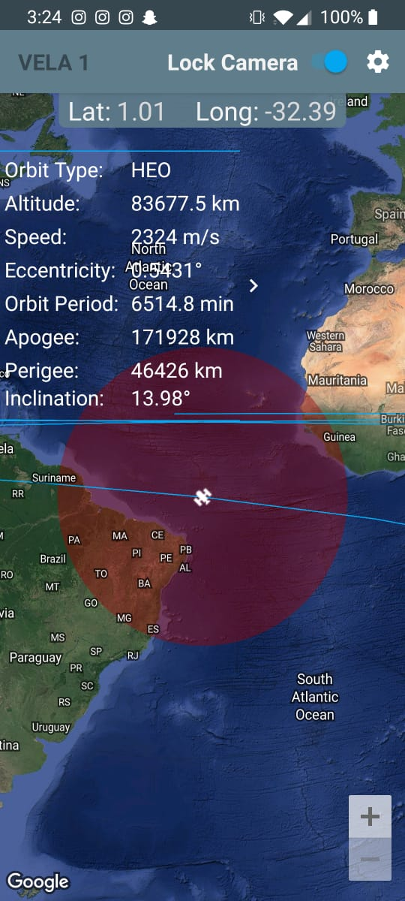
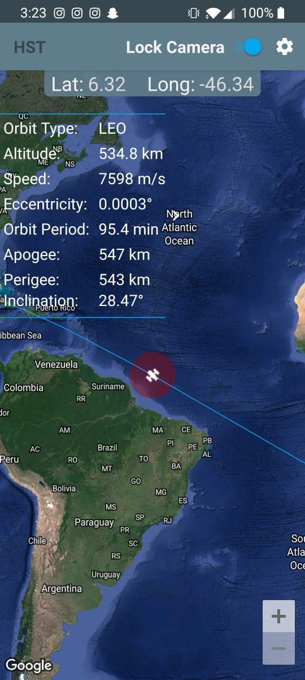
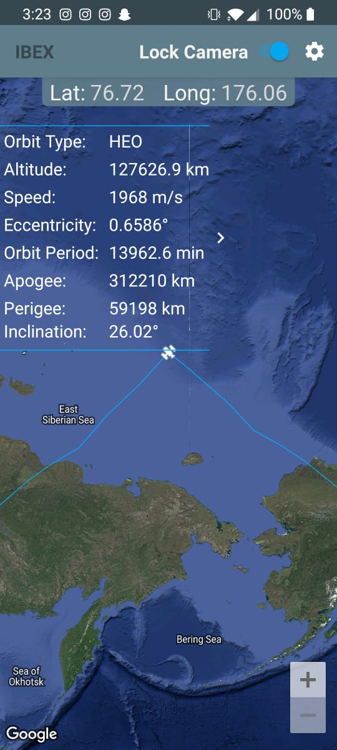
STEP 11: PERFORM SATELLITE TRACKING TO GET INPUT DATA

Slide 14
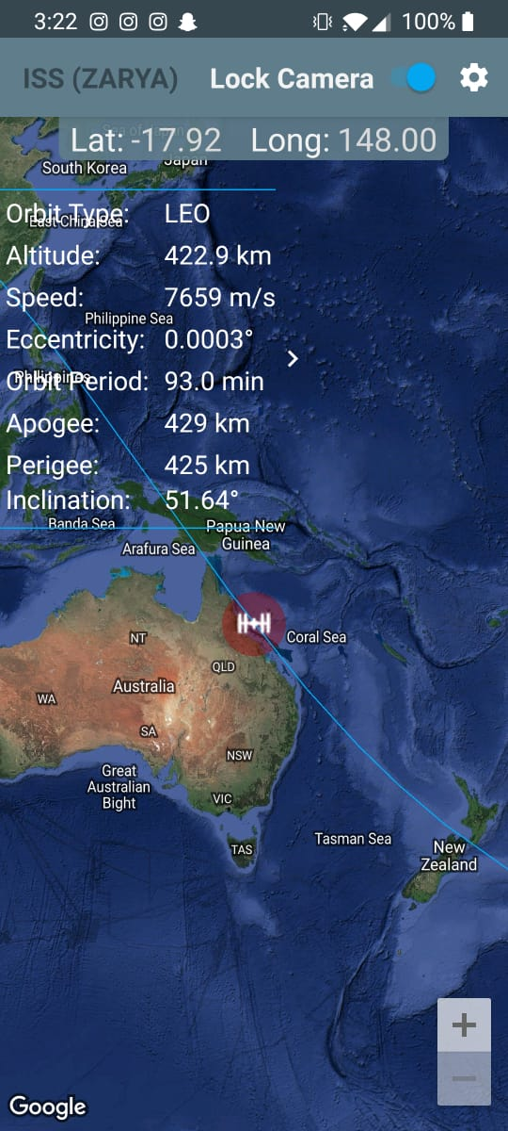
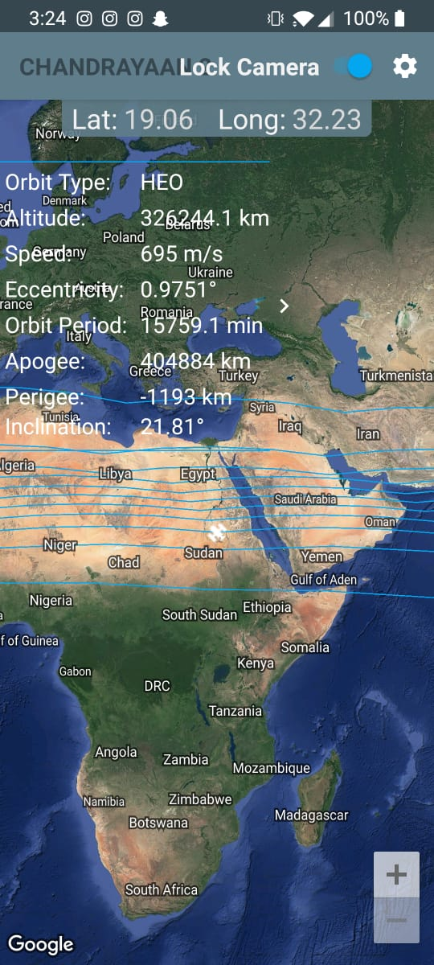
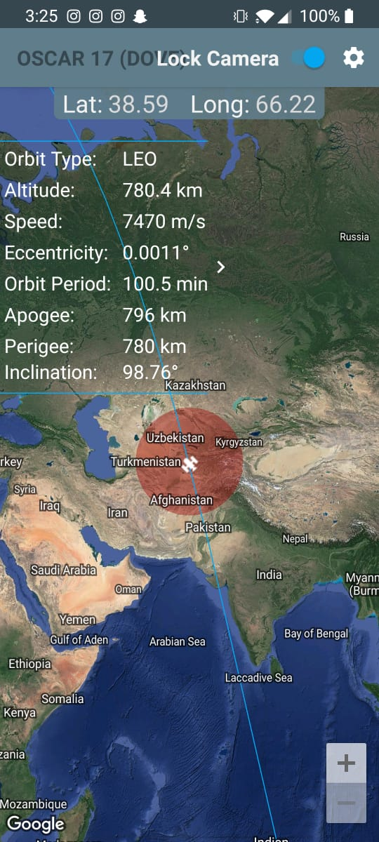
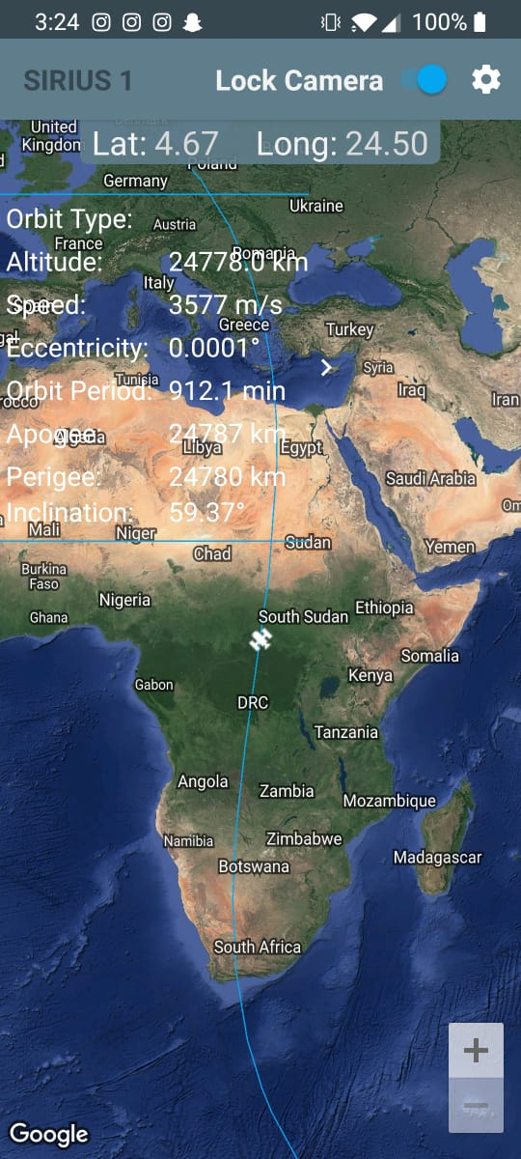
STEP 11: PERFORM SATELLITE TRACKING TO GET INPUT DATA

Slide 15
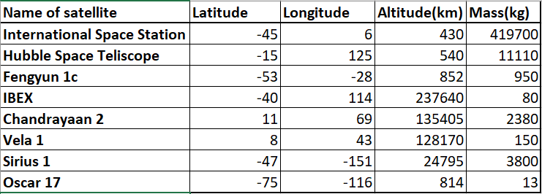
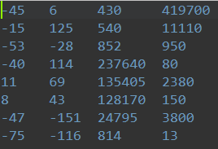
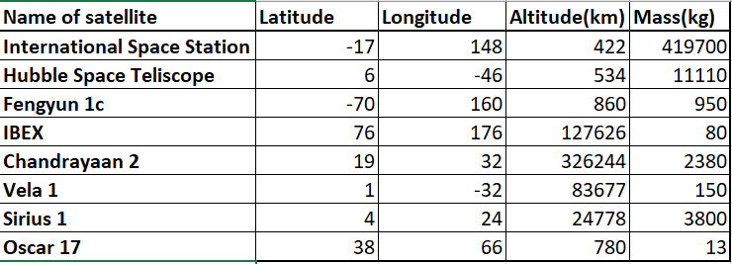
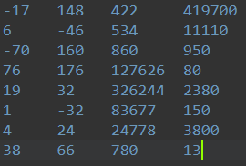
STEP 12: BUILD TEST DATASETS FOR SATELLITES

Slide 16
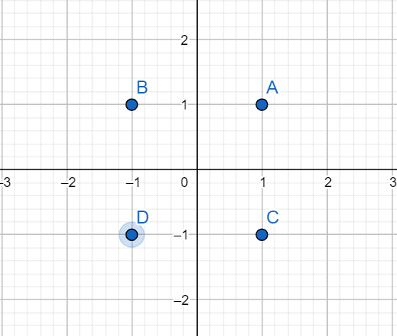
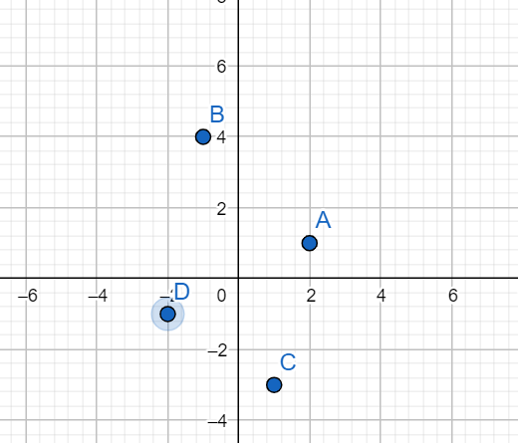

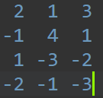
STEP 13: CONSIDER SYSTEM OF CHARGES TO GET INPUT DATA
EXAMPLE SYSTEM :
A = +2Q
B = +4Q
C = -Q
D = -2Q
EXAMPLE SYSTEM :
A = +3Q
B = +Q
C = -2Q
D = -3Q

Slide 17
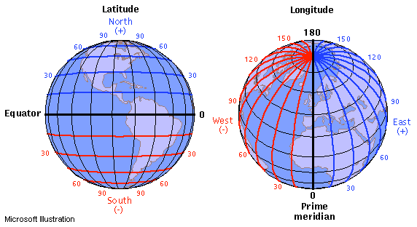
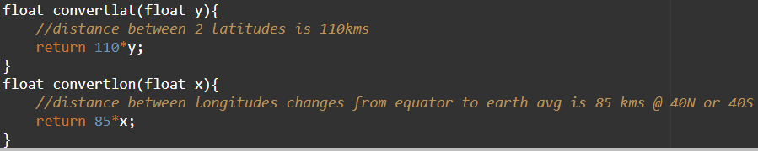
STEP 12: FUNCTIONS FOR CONVERSION OF LATITUDE & LONGITUDE TO KM

Slide 18
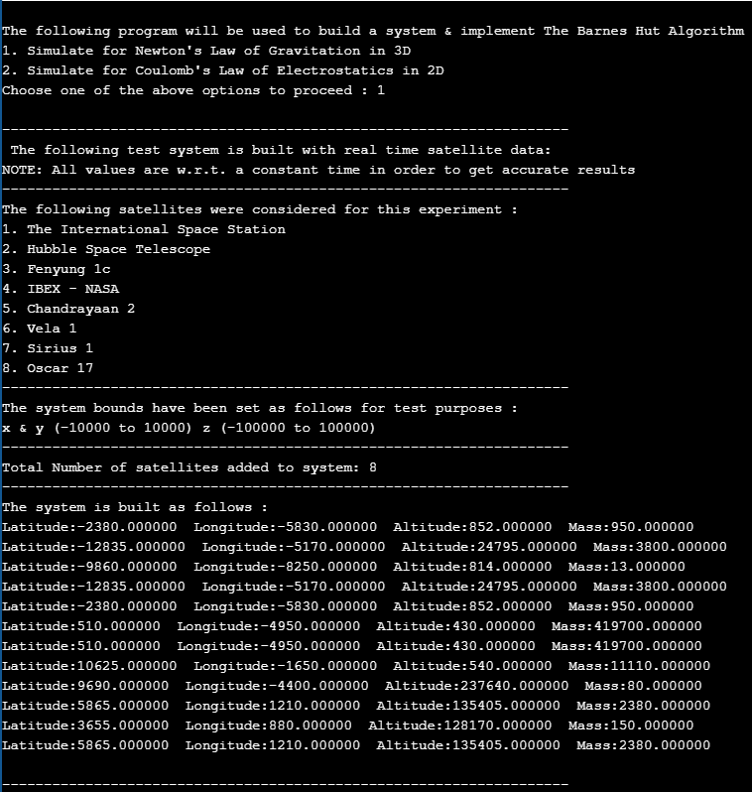
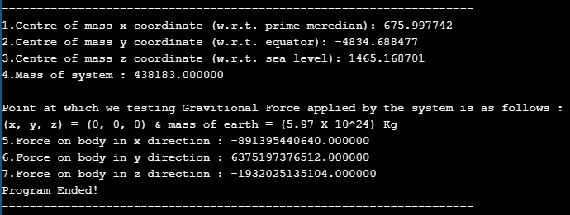
STEP 13: OUTPUT – DATASET 1

Slide 19
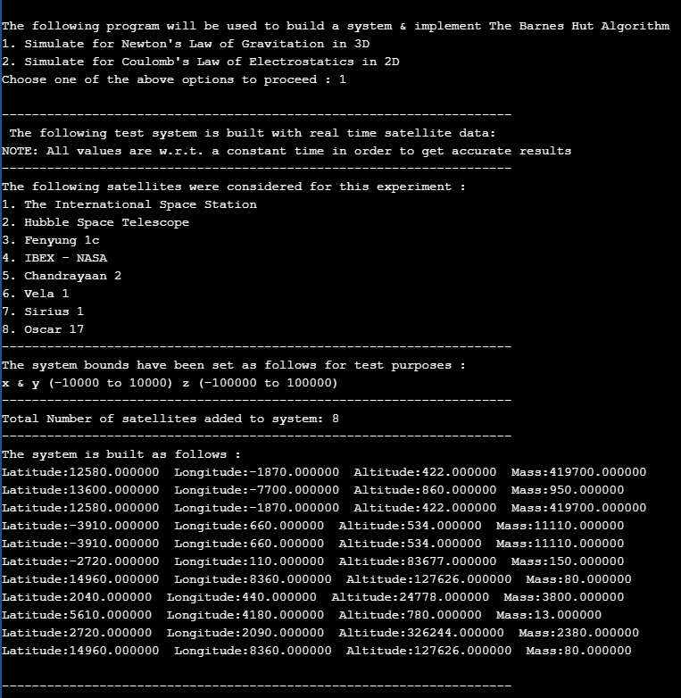
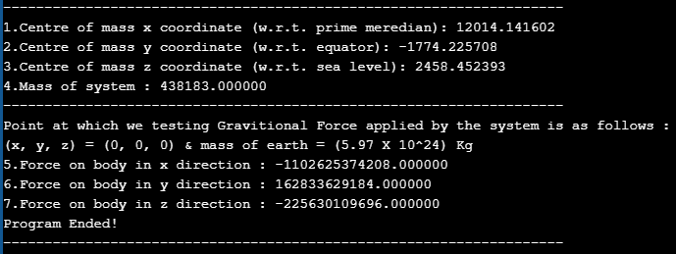
STEP 14: OUTPUT – DATASET 2

Slide 20
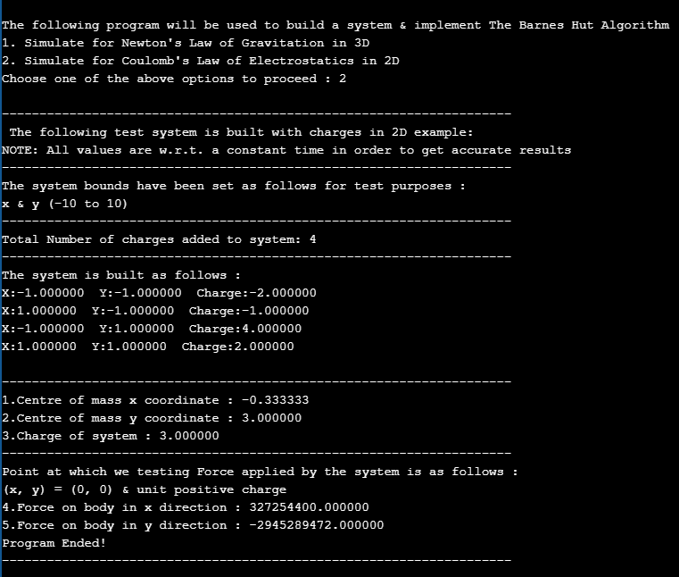
STEP 15: OUTPUT – DATASET 3
EXAMPLE SYSTEM :
A = +2Q
B = +4Q
C = -Q
D = -2Q

Slide 21
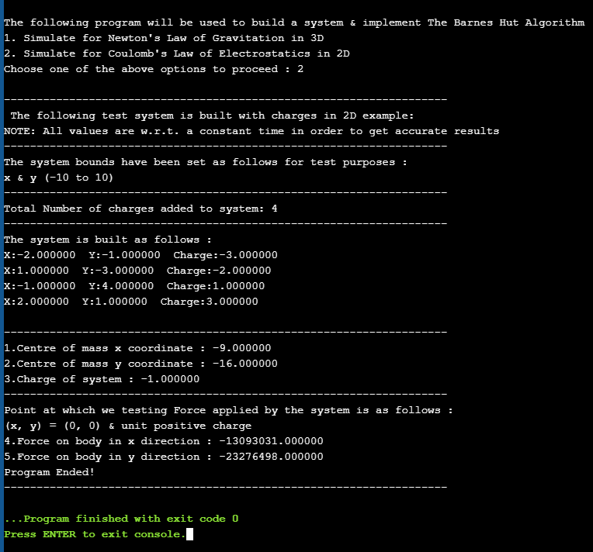
STEP 16: OUTPUT – DATASET 4
EXAMPLE SYSTEM :
A = +3Q
B = +Q
C = -2Q
D = -3Q

